Slide 1
Alpha Build Prototype Game/App Title
Student Name
Lab 01
Admin No
Date

Slide 2
Possible Content (not exhaustive)
Project Management
Recap the overall schedule
Describe the progress of project
are the tasks completed on time
Tasks dropped or added
If there are delays, what's the plan to catch up
Report to cover the following in details (highlight any changes from earlier pitch document if any)
Concept
Mechanics Completed (Partially Completed)
System Design (OOP, Walker algorithm)
Story
Unique Selling Point

Slide 3
Alpha Build (Other deliverables)
URL to unlisted youtube link for demo
E.g. https://youtu.be/xxxx (replace with yours)
URL to download the alpha demo build (your github link / googledrive or where we can get the zip)
E.g. https://github.com/xxxxx (replace with yours)
URL to download the source code (your github or googledrive or where we can get your source code)
E.g. https://github.com/xxxx (replace with yours)
(Make sure you share your github/googledrive with your supervisors gmail + Mr Choo if you haven’t done so)

Slide 4
Concept
Roguelite/Roguelike genre
Top Down
Procedurely generated levels where players must exit to complete
Limited in-game days to reach a certain amount of money
Combat with variety of enemies
Collect treasures and Gems
Wow factor:
- Gems as money or projectile weapon
- Party system
- Adaptive difficulty
Notes:
Gemquest is a roguelite/roguelike top down game, with combat, procedural generation, and has limited in-game days to increase profit. The wow factor is that gems, the main item for you to increase your currency can be used as weapons too, party system which ill explain later, and adaptive difficulty which ill explain later too

Slide 5

Story
A mining company is going broke and one of their most lucrative mining locations is about to shut down. They desperately needs help and the only applicant happens to be your playable character, Joe and you have limited days to increase the profit (Mine$)
Notes:
The story is that you are joe, a newly hired worker for a mine that is going broke, and it’s up to you to increase their mine$ (in-game currency) before a certain number of in-game days are finished

Slide 6
Gameplay loop
Hub World (Preparation, use mining company’s money (Mine$) to buy)
Enter procedurely generated mine
Fight enemies, collect gems and/or treasures
Exit the level to complete, where the gem’s/treasure’s system will be added to the (Mine$) money
Notes:
The gameplay loop starts at a hub world, where you will enter a procedurely generated mine, fight enemies and collect gems inside the mine before exiting, then repeat to increase the in-game currently, we’ll call mine$

Slide 7






Core Mechanic – Combat
Weapon
Player
Player
Enemy
Gem Projectile, except for blue gem
Basic attack – spin 360 degrees
Notes:
The melee combat will work like this, where it spins one rotation. And You can use gems as projectiles to attack enemies too. It is pretty simplistic

Slide 8

Core Mechanic – Gems
Can be used as currency, the main item to increase Mine$ when players exits the level with it
Gem | Effects | Get Via
Red Gem | Explodes surrounding walls, Burning | Looking for treasure chests Killing enemies Complete Quests in mines
Green Gem | Poison Slows
Blue Gem | Shield Shockwave when hit
Notes:
What adds some complexity is that Each gem will have their own different effects, burning and explosion for red, poison and slowing for green, followed by shield and shockwave for blue. Youll get gems by killing enemies, complete quest in mines or looking for chests

Slide 9
Core Mechanic – Enemies
Examples
Enemy | Attack Pattern
Basic Enemy | Attacks when near Player
Tank Enemy | Charging attack with high damage, can only charge in one direction
Shooter Enemy | Can replicate the projectile player has thrown before, else it will just throw normal projectile
Notes:
My game will have variety of enemies, and These are the examples of enemies with their own definitive attack pattern

Slide 10
Core Mechanic – Party System
AI Mode
Player mode
Toggle
Player Mode
AI Mode
AI Mode
AI Mode
Notes:
You can toggle between the characters in your party in the level, and the other’s will be controlled by AI if you’re not controlling them

Slide 11
Core Mechanic – Party System
Character | Strengths | Weakness
Joe (STARTING CHARACTER) | NIL | NIL
Veteran | More basic attack damage Less damage taken | Gem abilities, gems will have shorter effect time
Professor | Gem abilities, gems will have greater effect time | Less basic attack damage
Earn by getting a certain amount of Mine$
Notes:
And this is the party system, where you’ll unlock characters with different strengths and weaknesses after earing a certain amount of mine$. You start with joe at the beginning of the game

Slide 12
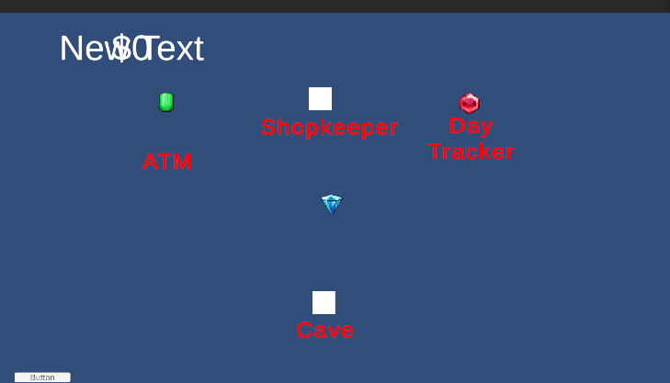
Core Mechanic – Hub World
Where players go after every level exit
Shop to spend Mine$ on supplies, but be careful not to spend too much
Atm to donate Mine$
Day tracker to track days
Notes:
You also have a hub world, where you will go after every level completed, and you can spend mine$, but be careful to manage your currency else the earnings will not be enough to reach by the end of the day

Slide 13
System Design – Enemies (OOP inheritance)
Character.cs
-Health
-Gem effects
-UnityComponents
-Damage
Enemy
- FSM Transitions
Player
- FSM Transitions
- Attack Pattern
Tanker
Shooter
Basic

Slide 14
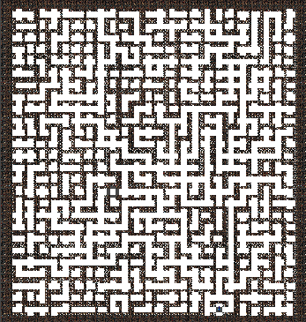





System Design – Map Generation (Walker Algorithm) (Incomplete - Unoptimal)
Starting area
Exit
Definitive path
Diverging path
Alpha only has fixed level now
Notes:
This is how the procedural generation will work, it will generate a direct path between starting and ending room, Diverge it with more paths, then complete it with additional rooms

Slide 15
Milestone
Week 1
Week 8
Week 14
Week 17
Alpha | Beta | Final
Completed: Enemy Gems Hub World Gameplay Objective/Loop Continue: Procedural Generation Party/Player System Shop Audio UI Animations Might Scrap: Adaptive difficulty | Tutorial system Mine Quests Play test Audio UI Animations Might Scrap: Optional Quests Treasures Boosters | Polishing Play Test Audio UI Animations
Notes:
This is my milestone, the first 8 weeks is to get the alpha running, which is to implement the core features and gameplay loop first, then the Beta stage will add the additional mechanics I mentioned before playtesting, then the final weeks will involve polishing and further playtesting.

Slide 16
Additional Mechanics
Notes:
I will now present the additional mechanics for variety that I will or potentially could add

Slide 17
Mechanic – Adaptive difficulty
The tier will increase the more times the player exits the mind without dying.
If player dies, the difficulty will decrease
Difficulty Tier | Length of definitive path between exit and entrance | Quantity of enemies per level | Health of enemies
1 | 20-30 | 50 | 50-100
2 | 30-40 | 60 | 100-200
3 | 40-50 | 70 | 200-300
4 | 50-60 | 80 | 300-400
Notes:
Adpative difficulty, where enemies and length of the definite path in the level will be more difficult to navigate the more player plays without dying

Slide 18
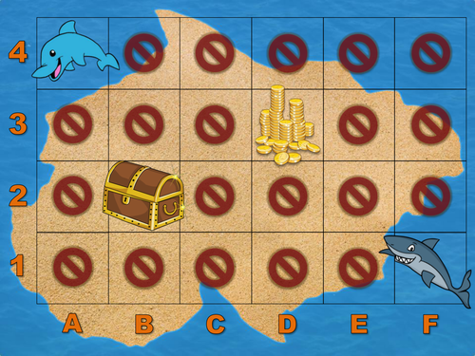
Mechanic – Optional Quests (Treasure collection)
Can collect either through treasure chests or killing enemies
Treasures, while have no abilities, can be sold at higher values
Complete their collection by just finding and exit with them
Notes:
Optional treasures, where you can collect and sell treasures which value is significantly higher than gems, and there will be a stamp board to indicate what have you collected

Slide 19
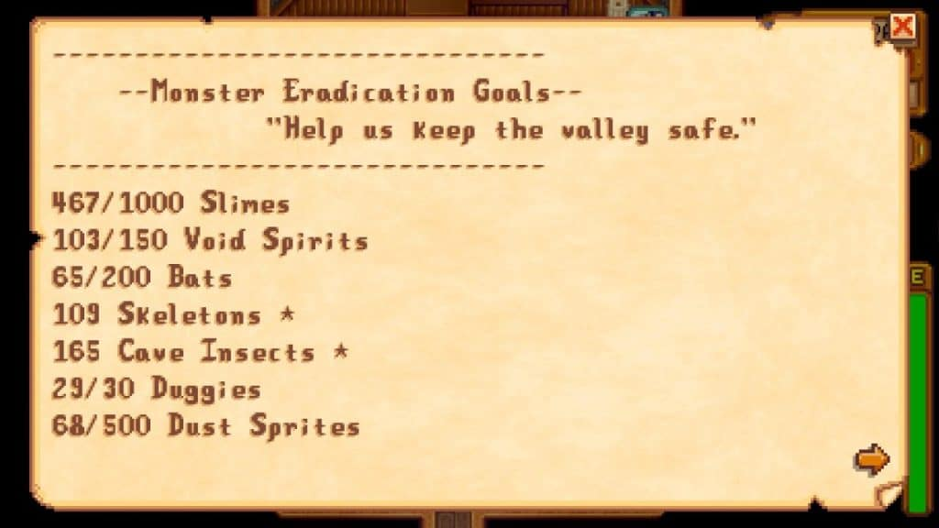
Mechanic – Optional Quests (Monster killing)
Kill a certain amount of monsters
Each quantity of monster killed will be given rewards
Notes:
A tracker to indicate a certain amount of enemies you have to kill before getting certain rewards

Slide 20
Mechanic – Optional Quests (Mine quest)
Only can be completed inside the mine
Interact with NPCs inside the mine to start the quest
Examples
Types of quest | How to complete | Rewards
Collection quest | Give npc a certain number of items/treasures | More gems Temporary boosters Treasures
Combat quest | Kill a certain number of enemies
Rescue quest | Bring the npc to the exit
Notes:
And these are the examples of the types of quest you can encounter via npcs in the mine during the level gameplay for additional rewards

Slide 21
Mechanic – Boosters
Temporary power-up
Collected via completing quests, killing enemies or treasure chests
Examples
Types of Boosters | Function
More gems | Enemies/chests will drop more gems
Morale | Strengthens the players’ attack during AI mode
Indiana | Sees treasure chests in walls
Notes:
And you can also interact with boosters, which are power-ups for a limited time, getting it via completing quests in the mine as stated in the previous slide, kill enemies or treasure chests

